Slide 1


The Application of Image Processing and Image Segmentation for Evaluation of Digital Pathology in a Woodchuck Hepatocellular Carcinoma (HCC) Model
Joshua Cheuk ^{1,2}
¹National Institute of Biomedical Imaging and Bioengineering, National Institute of Health, Bethesda, MD,
²Center for Interventional Oncology, Clinical Center, National Institute of Health, Bethesda, MD

Slide 2
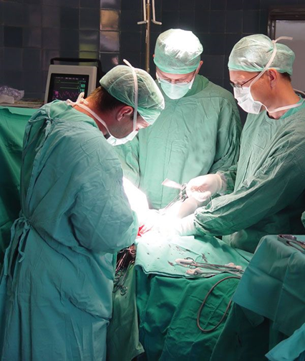
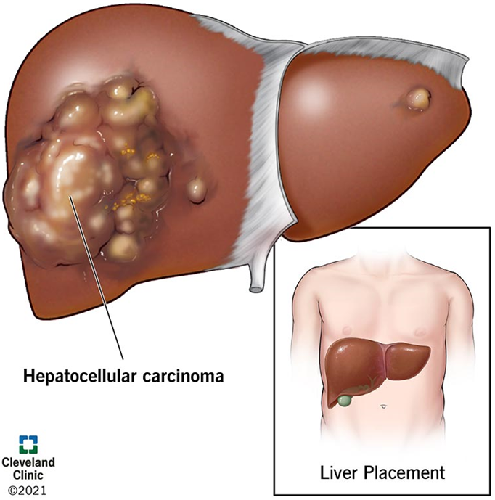
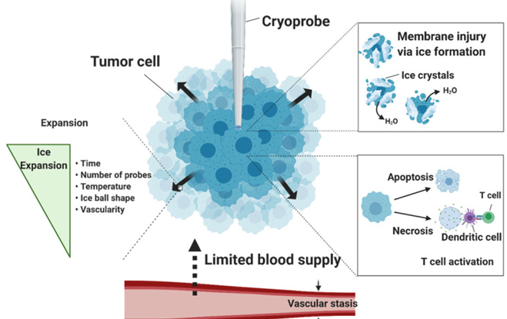
Background
Liver cancer : Hepatocellular Carcinoma (HCC)
Responsible for 12,000 deaths per year
Common treatments include surgery, liver transplant, and locoregional therapies

Slide 3
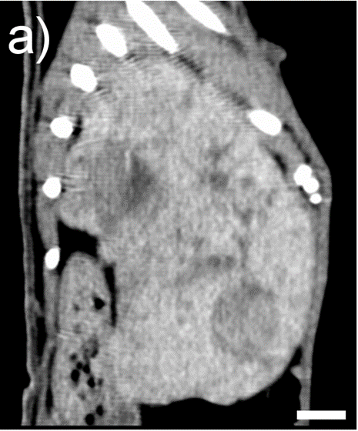
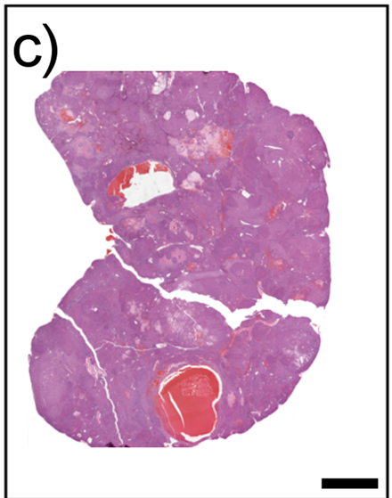
Background
CT slice in sagittal plane of a woodchuck
Treatment requires locating and diagnosing HCC
CT scans are used to detect HCC location
Requires Biopsy of tissue for pathology sample (slide) to evaluate the cancer
Histopathology section stained with H&E. Scale bars represent 1 cm

Slide 4
Objectives
Create and implement image processing and image segmentation techniques for cell count on woodchuck liver H&E digital pathology slides.
Measure accuracy of the image segmentation model

Slide 5
Methods Overview
Image Processing
Select 3 Representative Samples
Image Segmentation
Compare Results to Measure Accuracy

Slide 6








Methods
Image Processing Requirements
Machine Learning (ML)
Optimize image for humans and/or machine viewing
Libraries used in Python 3.14
Cv2, Skimage, Matplotlib, Numpy, Scipy, Openslide, Pillow

Slide 7
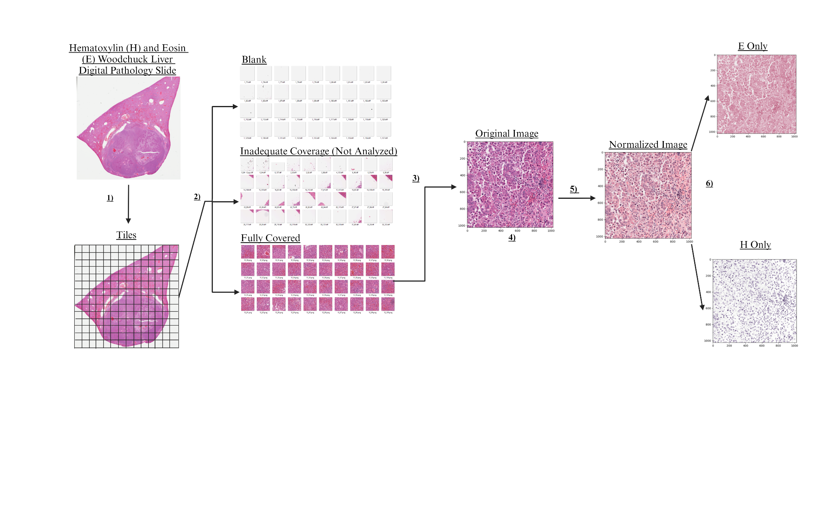
Methods-Image Processing of Woodchuck HCC Stained Liver Samples
Tile Processing (6 steps)
Step 1. Use Openslide, Pillow, numpy, and Matplotlib to separate H&E stained slide into tiles
85,679x80,708 pixel H&E slide
Split to 256x256 tiles
Hematoxylin (H) stains nuclei
Eosin (E) stains cytoplasm
H&E slide is a nuclei and cytoplasm stained slide

Slide 8
Methods-Tile Processing
Step 2. Manually sort tiles as blank, inadequate coverage, and full coverage.
The average pixel value (APV) of each cell coverage type was determined

Slide 9
Methods-Tile Processing
Step 3. Take average pixel value (APV) and standard deviation of pixel value (SDPV) of the blank, inadequate coverage and full coverage tiles, respectively.
Selected slides that satisfied the average pixel value for full coverage tiles

Slide 10
Methods-Tile Processing
Step 4. Use APV and SDPV of full coverage tile to estimate the range of APV for tile selection

Slide 11
Methods-Tile Processing
Step 5. Use Openslide to normalize the H and E pixel values respectively
Normalization changes the pixels that make the Hematoxylin (H) stained nuclei distinctly purple and the Eosin(E) stained cytoplasm distinctly pink

Slide 12
Methods-Tile Processing
Step 6. Separate the H from E after normalization
E-only = cytoplasm
H-only = nuclei

Slide 13
Methods
After image processing we selected 3 representative tiles to illustrate different cell coverage types that the image segmentation model may come across
Sample 1: Full coverage tile
Sample 2: Substantial coverage tile
Sample 3: Full coverage tile with blood vessel
The image segmentation model was applied across the three sample types for:
Original tile: no modifications
and the processed tiles
Normalized tile: showing cytoplasm distinctly pink and nuclei distinctly purple
H-only tile: showing distinctly purple nuclei
Original
Normalized
H-Only
Sample 1
Fully Covered Tile
Sample 2
Substantially Covered Tile
Sample 3
Fully Covered Tile with Blood Vessel

Slide 14
Methods- Manual Cell Counting
Presence of nuclei implies presence of intact cell
3 independent qualified readers manually counted cells for each sample type in the original, normalized and H-only slides
A comparison of cell count with the image segmentation model was also conducted for each sample type in the original, normalized and H-only slides
an average nuclei count was defined for both the manually counted and image segmented tiles
Original
Normalized
H-Only
Sample 1
Fully Covered Tile
Sample 2
Substantially Covered Tile
Sample 3
Fully Covered Tile with Blood Vessel

Slide 15
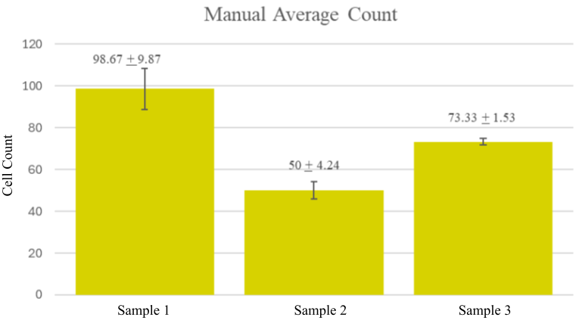
Results- Manual Cell Counting
Manual Average Count across samples
Sample 1 -Average: 98.67 + 9.87 cells
Sample 2 -Average: 50 + 4.24 cells
Sample 3 -Average: 73.33 + 1.53 cells

Slide 16


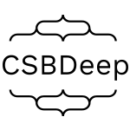

Methods- Image Segmentation Requirements
Machine learning (ML) model
Look for specific parts inside of an image
Used numpy, matplotlib, CSBDeep, Stardist, Seaborn, Pandas, Skimage

Slide 17
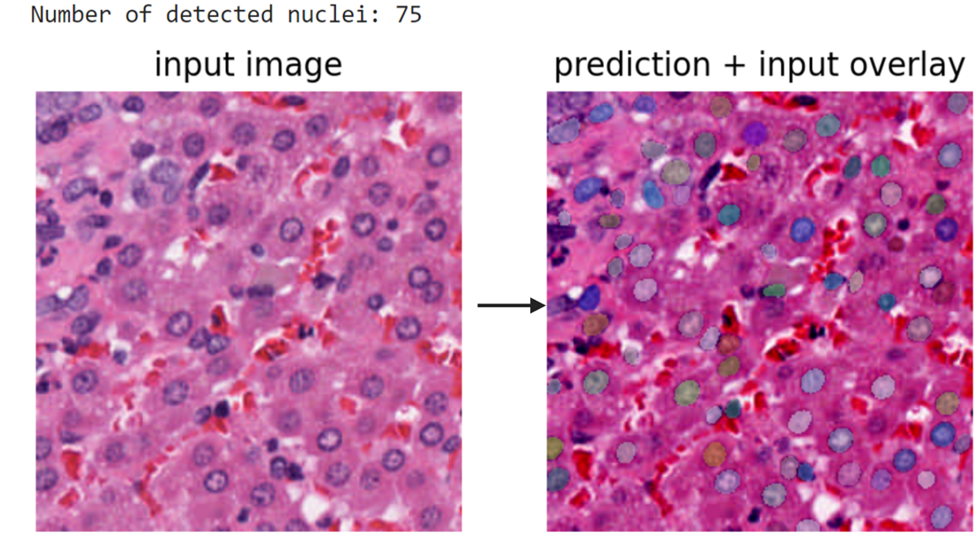
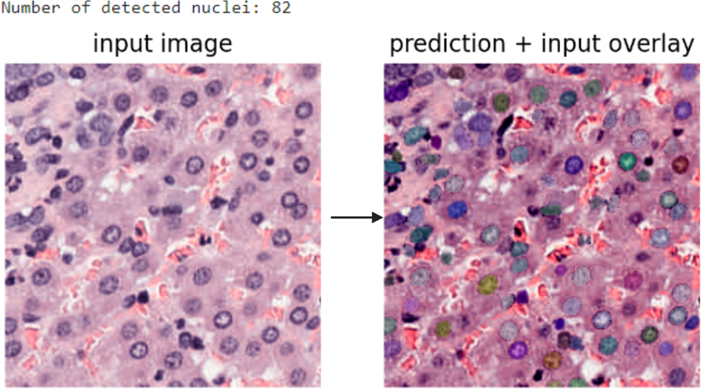
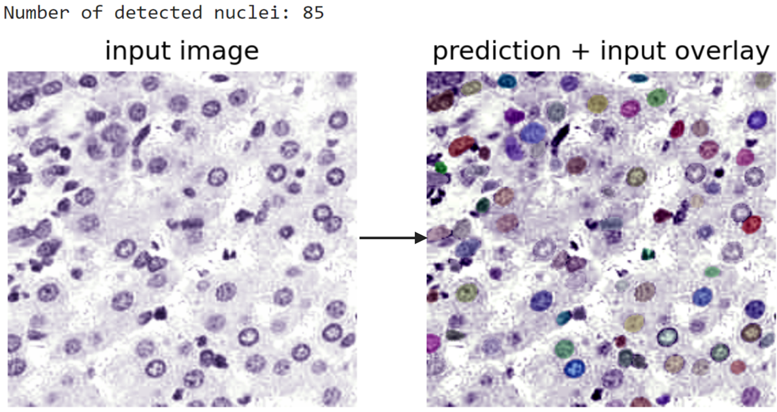
Methods- Image Segmentation with Original, Normalized, and H-only Fully Covered Tiles for Cell Counting
All representative tiles were segmented
Below is an example of sample 1 segmentation (fully covered tile)
Segmented slides were counted by the StarDist ML tool
The segmented count was compared to the manual count
Sample 1 Original
Sample 1 Normalized
Sample 1 H-Only Stain

Slide 18
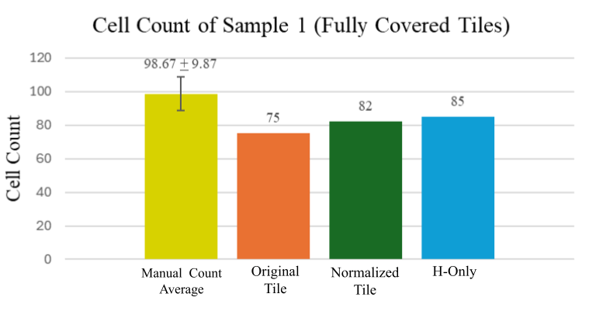
Results- Manual Compared to Image Segmented Cell Counts
For Sample 1
Segmented H-only tile had a cell count closest to the manual count
The Normalized tile was second closest to the manual count.
Slide Stain Type

Slide 19
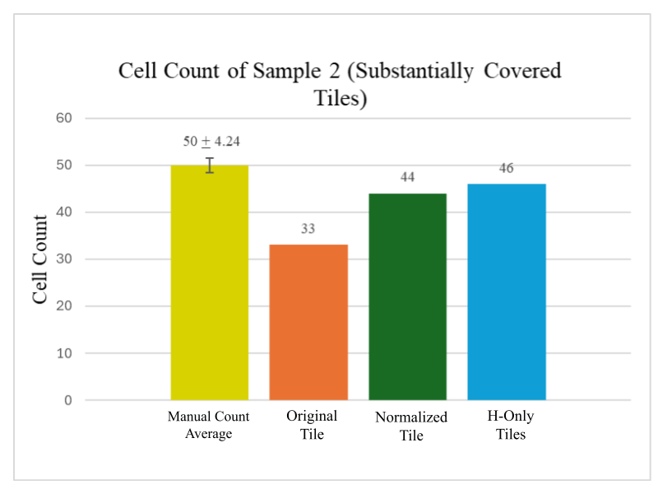
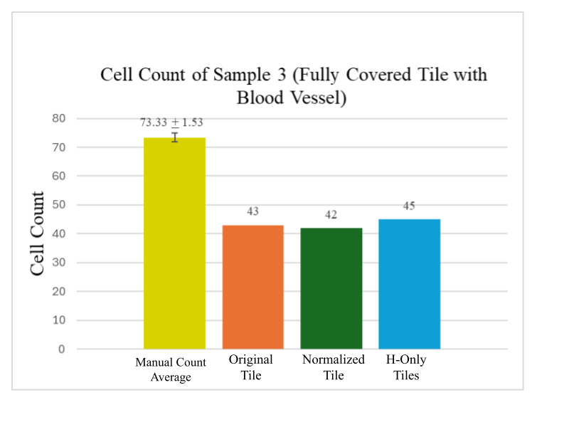
Results- Manual Compared to Image Segmented Cell Counts
For Sample 2 and 3
Segmented H-only tile had a cell count closest to the manual count
Slide Stain Type
Slide Stain Type
Notes:
Say what the graph is comparing

Slide 20
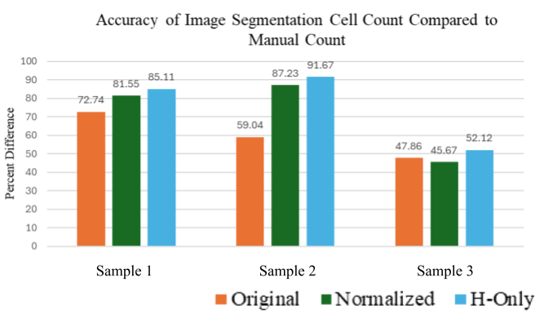
Results
For each sample type the H-Only tiles were closest by percent to the manual count
Sample 3 was the least accurate sample out of all samples

Slide 21
Conclusions
The StarDist image segmentation model had an easier time identifying the shapes of the cells in H-only tiles
StarDist image segmentation may not work best on samples with different structures
(e.g. endothelial cells associated with blood vessels) due to the unique shapes (e.g. sample 3)

Slide 22
Limitations
One limitation is using Openslide to normalize tiles instead of using StarDist
because StarDist has its own normalization model. So, the cell count may not be the most precise
Parameters (scale, probability threshold, and the Non-maximum suppression) were at default settings and can be optimized

Slide 23
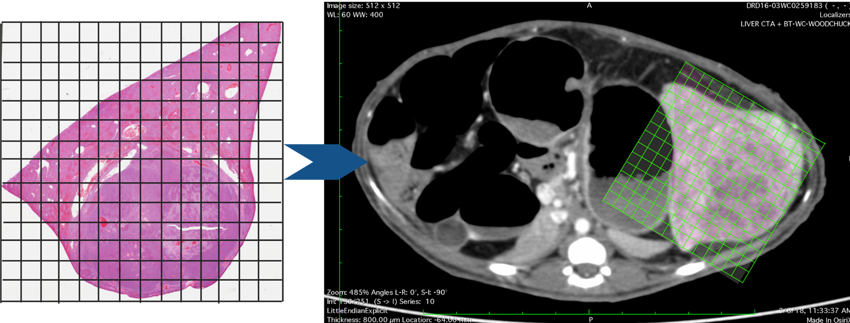
Future Directions
Identify structures on digital histopathology slides by putting tiles on a grid.
Identify structures on CT scan using radiomics.
Correlate Hounsfield unit of structure from CT scan to digital histopathology.
This is an image correlating histopathology slide to axial CT slice of woodchuck liver with HCC tumor by mapping the cell tiles from the H&E slide onto the CT scan

Slide 24
Acknowledgement
I would like to express my deepest gratitude to the National Institute of Biomedical Imaging and Bioengineering (NIBIB) for the opportunity to participate in the Biomedical Engineering Summer Internship Program (BESIP). My heartfelt thanks to Dr. Wood and the entire team at the Center for Interventional Oncology (CIO) for their invaluable mentorship and support throughout this research. Special thanks to Dr. Nicole Varble and Ming Li for their guidance, expertise, and encouragement, which was instrumental in this project.

